Slide 1
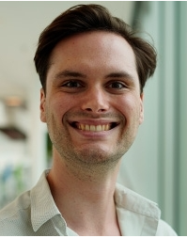
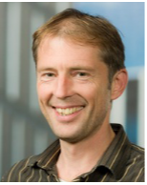
Daily Supervisor:
Mio Poortvliet
Main Supervisor: Dr. Wolfgang Löffler
Notes:
WL: remove evert, and move as appear animation to title slide then you can remove this slide?

Slide 2
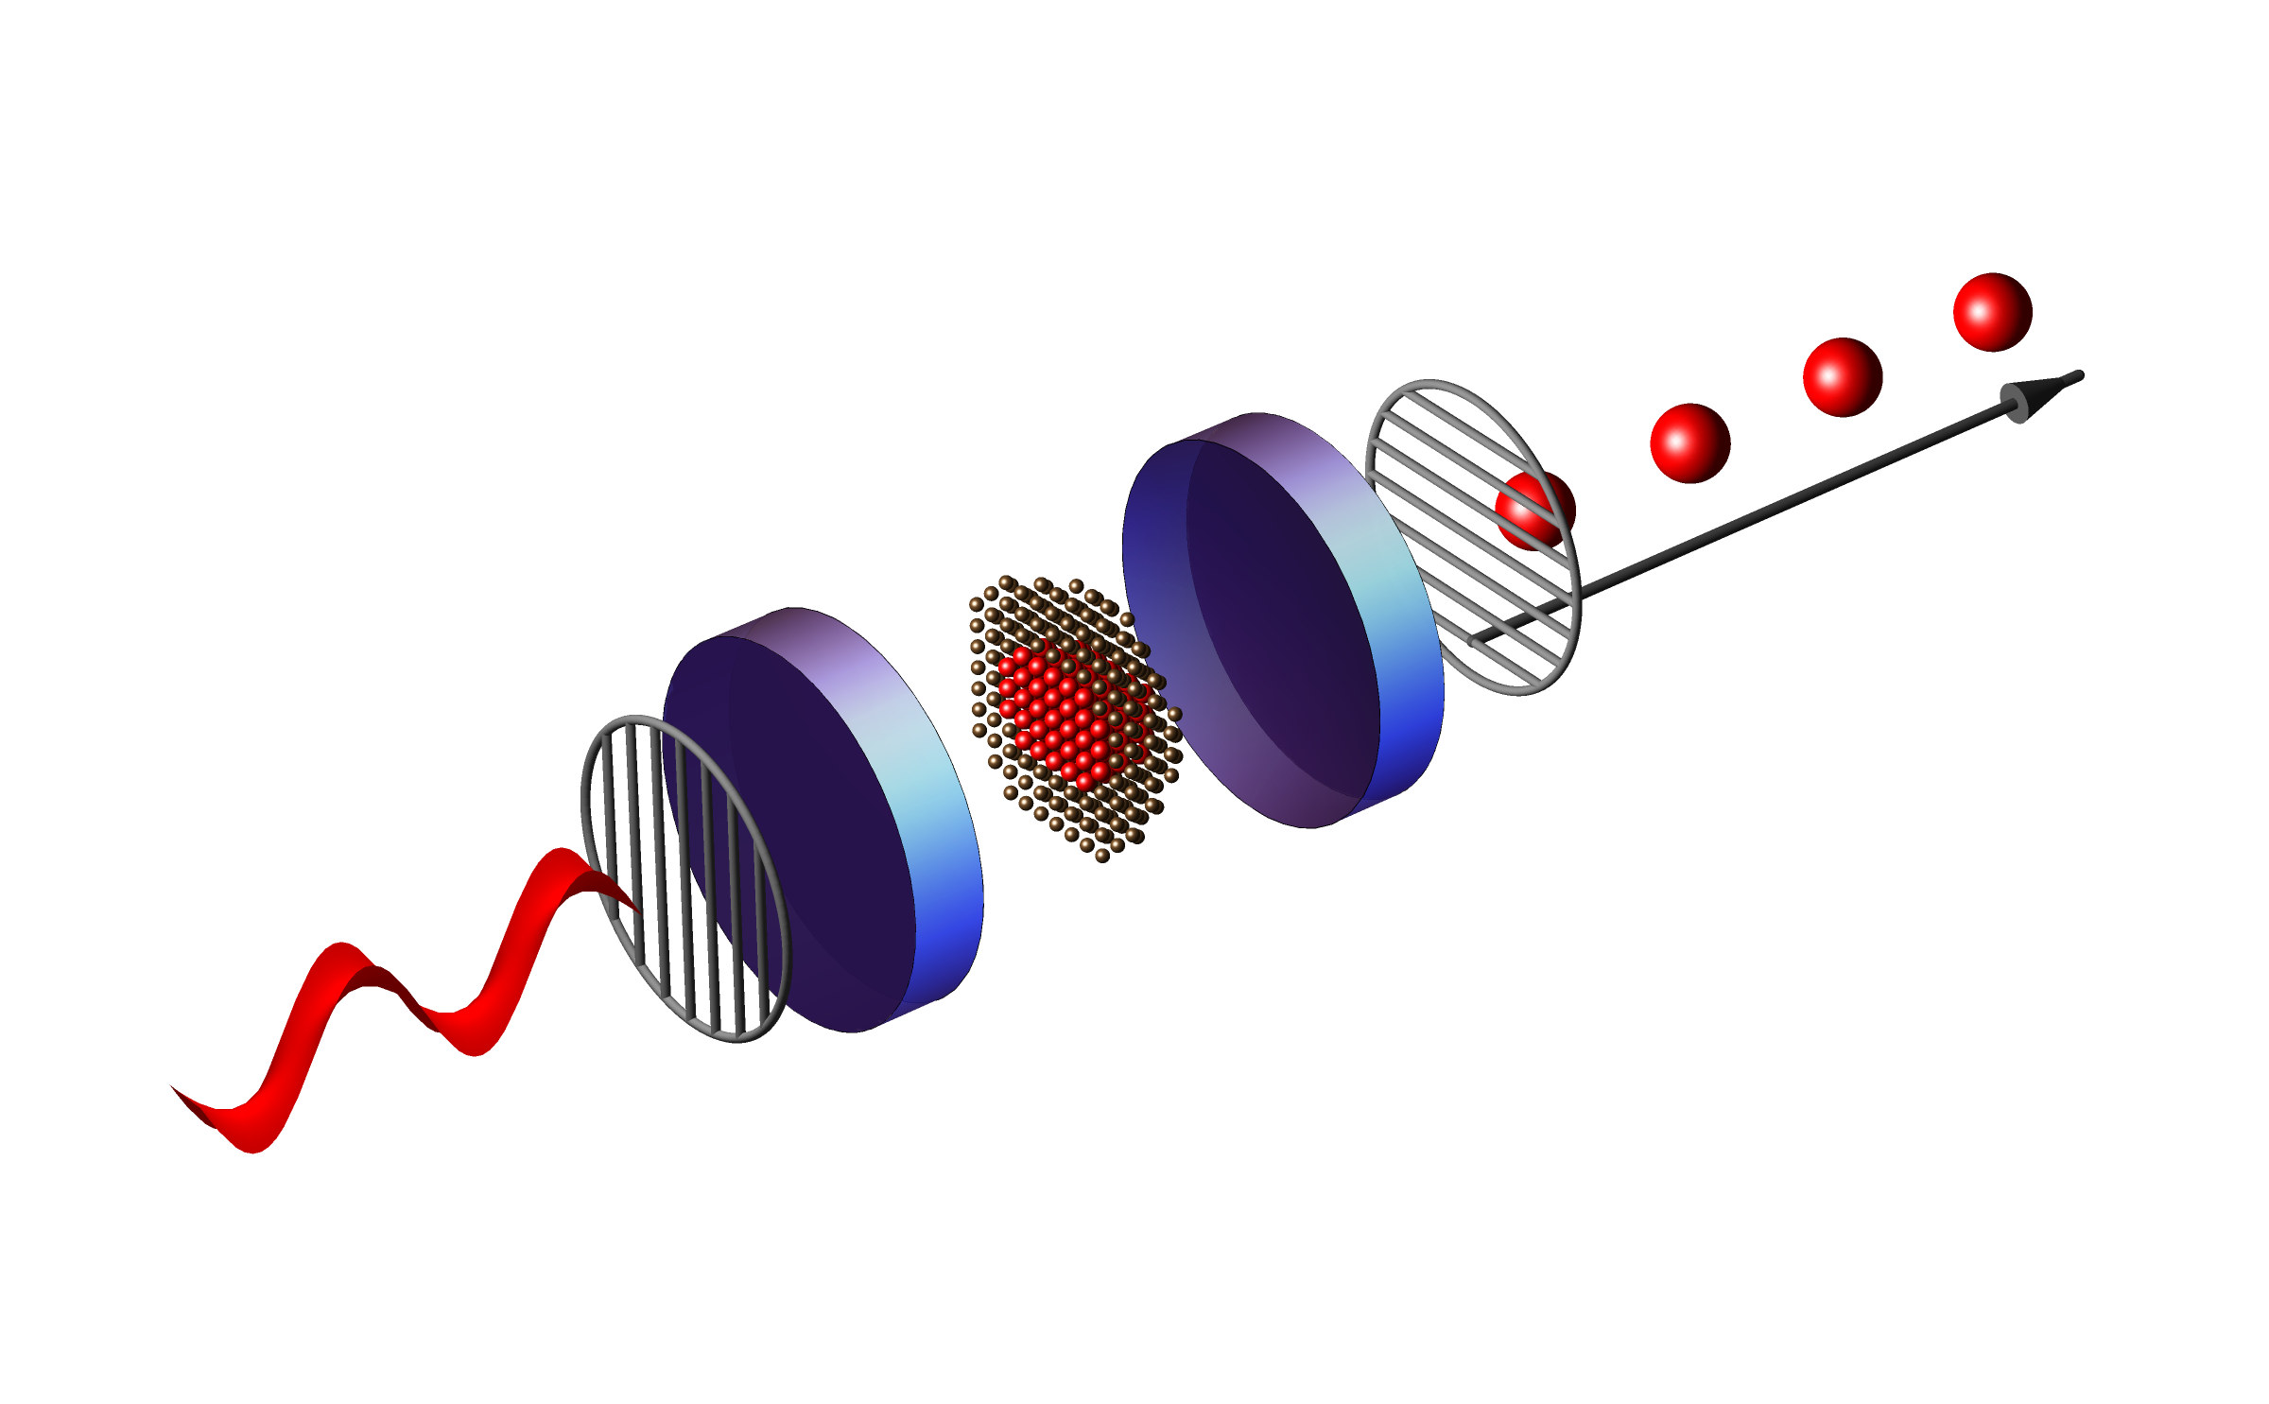
The effect of temporal jitter on single photon indistinguishability
Andrea Maccarinelli 5/16/2025
Notes:
Reemove all ‘disappear’ animations

Slide 3
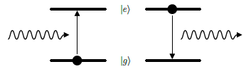

What is the main goal of my project ?
Boost Single photon indistinguishability
Study the features of the excitation pulses
Notes:
bienfang2023 Single-photon sources and detectors dictionary
usually the intended audience are your fellow students - if so you should briefly explain SPs or SPsource, 'SP indistinguishability', excitatiuon pulse! using pictures from our stuff.

Slide 4
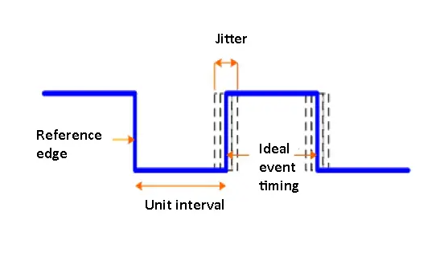
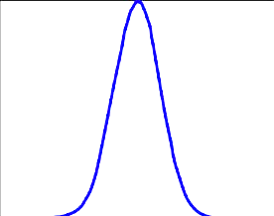
What is the Jitter of a signal ?
Random Source
Systemic Source
https://www.testandmeasurementtips.com/wp-content/uploads/2017/08/jitter-waveform.jpg
Rev. Sci. Instrum. 95, 054703 (2024); doi: 10.1063/5.0191289

Slide 5
Implementing the study in our setup
Sets the delay
Sends trigger signal
Clock
FPGA
Pulse compressor
Quantum Dot
CW Laser
EOM
EOM

Slide 6
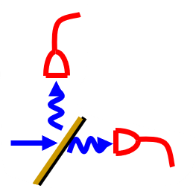
Current focus – Part I: Hanbury Brown–Twiss on excitation pulses
Clock
FPGA
Pulse Generator
SNSPD
CW Laser
EOM
EOM
Beam Splitter
@45º
Start/Stop
Timestamps
FPGA : Field-programmable gate array
EOM : Electro-optic modulator
SNSPD : Superconducting nanowire single-photon detector
Notes:
WL i would compressor -> generator , and write out abbreviations. advise: use more straight lines, and stick to cartesian coordinates (beamsplitter is at 45 deg).
To make more funny: add photo picture of single photon detectors?

Slide 7
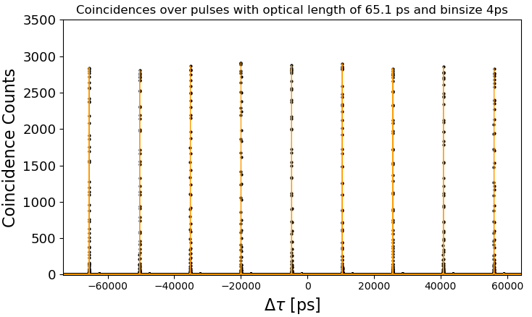
From timestamps to coincidences histograms
.bin file
Relative time between Start & Stop events in ps
Index
Timestamp
Timestamp * Reference clock
Pulse Train From one detector
1.5
1.8
1.4
1.5
1.6
Detector 1
2.2
1.5
1.4
1.6
1.5
Detector 2
Notes:
WL: put ttags “1.5ps” etc in bins?

Slide 8
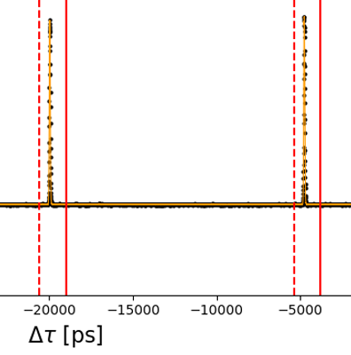

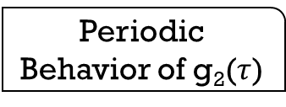
Fitting the peaks in g₂($τ$)
What we need ?
Gaussian fit of every peak
Periodic Behavior of g₂($τ$)
Periodic Boundaries
Notes:
WL never coverts anything in slides – it’s just hard work to make it nice!
Show single peak fit to show audience how good or bad a fit is?
G2 peaks plot: “suspect” very unclear – WL would ask a question:“what is this???” then wait , show picture with HBT setup – then this could be tau=0 peak! BUT then I would not have 0 on the x-axis.

Slide 9
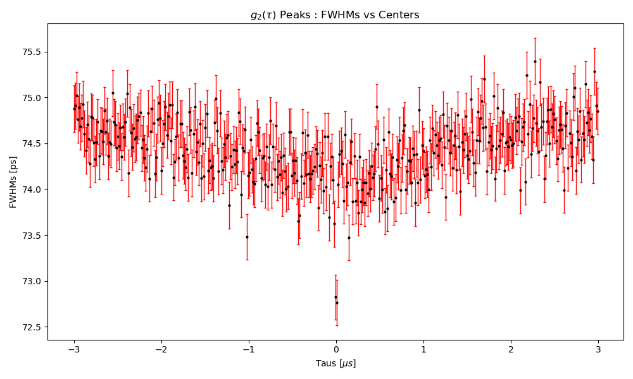
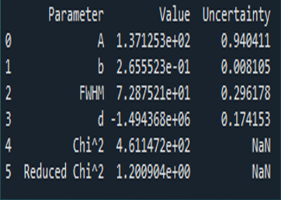

Fitting the peaks in g₂($τ$)
Saving Dataframes of every fit into .CSV files
$$τ=0$$
SUSPECT NO.1
Offset Correction

Slide 10
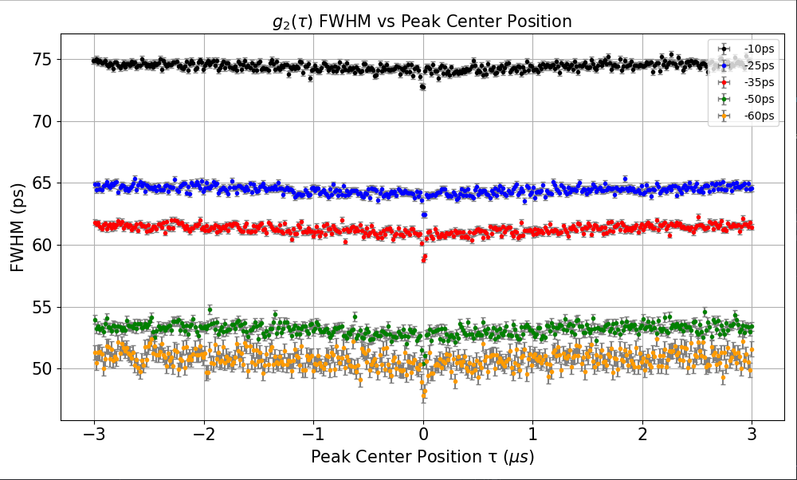

How the pulse length affects the FWHM of the peaks of the g₂($τ$)?
65.1ps
Optical Lengths
55.5ps
49.8ps
41.4ps
37.2ps
Independently measured
Notes:
Left: label: optical pulse length (measured independently)
Either know the answer to the question if both numbers agree (left/right), or say I will do in future.

Slide 11
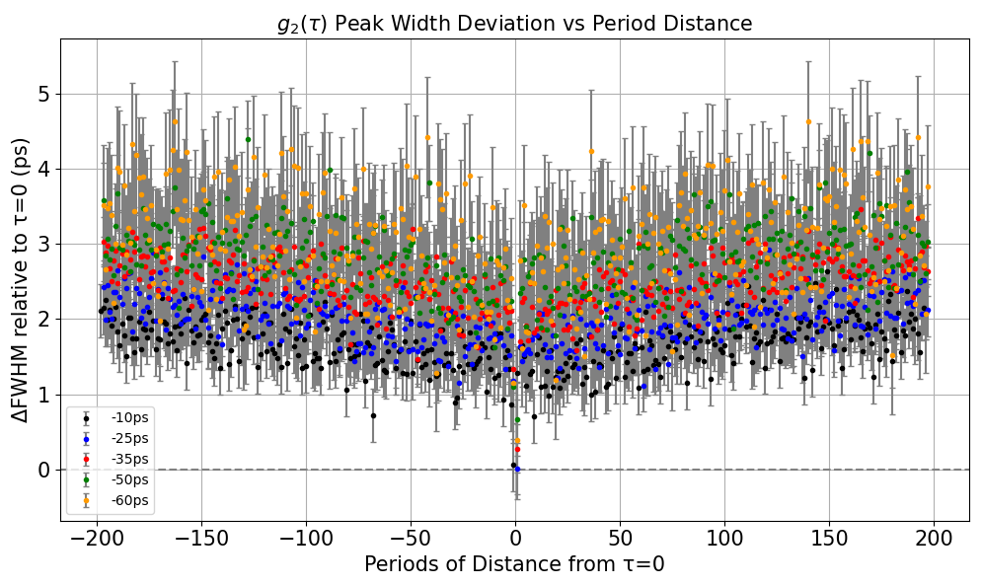

Can we detect broadening in g₂($τ$) peaks via FWHM variations?
What do I expect ?
Broadening of the widths with the increase of the distance
What do I get ?
Slight absolute linear increase
Apparently more evident for shorter pulses
Pulse Length
65.1ps
55.5ps
49.8ps
41.4ps
37.2ps
Notes:
WL: add animations, appear
WL: future: add sketch that shows what DeltaFWHM is (nobody except Mio & W knows)

Slide 12
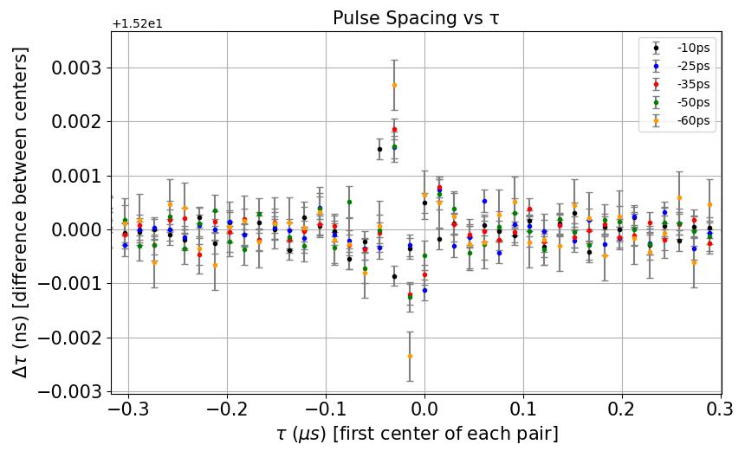
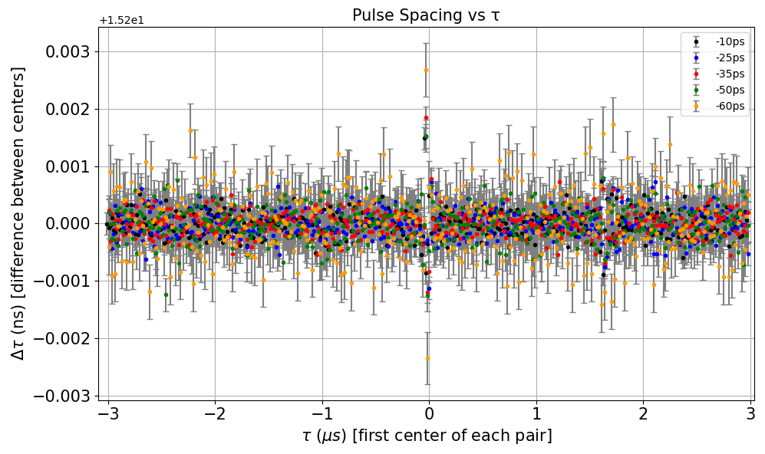
Verifying the stability of the FPGA clock
Extraction of Timestamps already implements this
What do we expect ?
Roughly constant behavior
Pulse Length
65.1ps
55.5ps
49.8ps
41.4ps
37.2ps
Not messing things up
BUT…
Not yet clear behavior near zero
Notes:
WL: would make two slides, never remove stuff (and don’t cover important things – then you can also make a nice simple PDF!

Slide 13
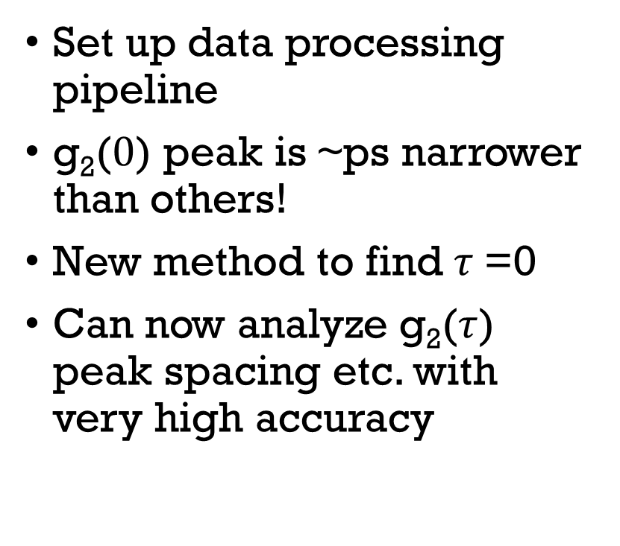
What’s next ?
Summary
Set up data processing pipeline
g₂($0$) peak is ~ps narrower than others!
New method to find $τ$=0
Can now analyze g₂($τ$) peak spacing etc. with very high accuracy
Obtain the detector response function
Allan variance study on FPGA’s reference clock
Study the impact on single photon indistinguishability
Notes:
WL: don’t arbitrarily capitalize words… wrong

Slide 14
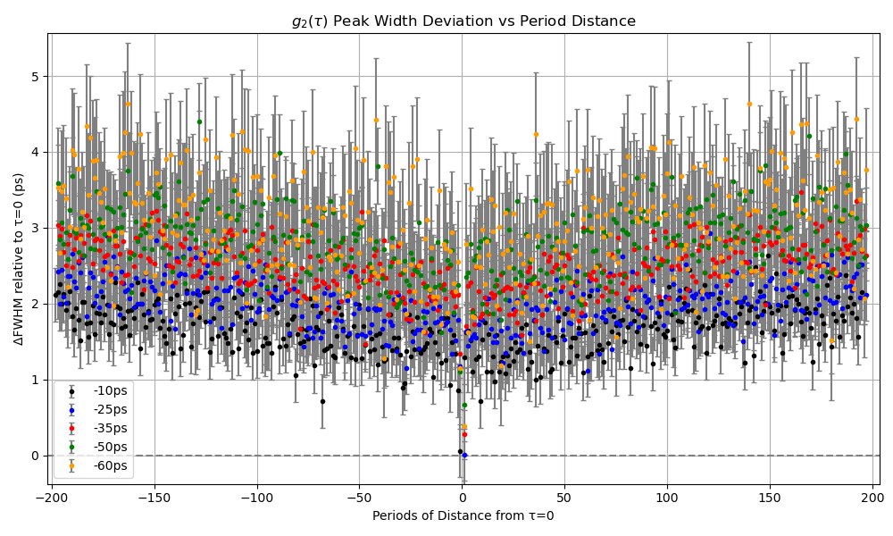
Any Questions ?

